Slide 1
WEB DEVELOPMENT
Kvub Ravi Seshu
222010313010

Slide 2


Slide 3


Slide 4
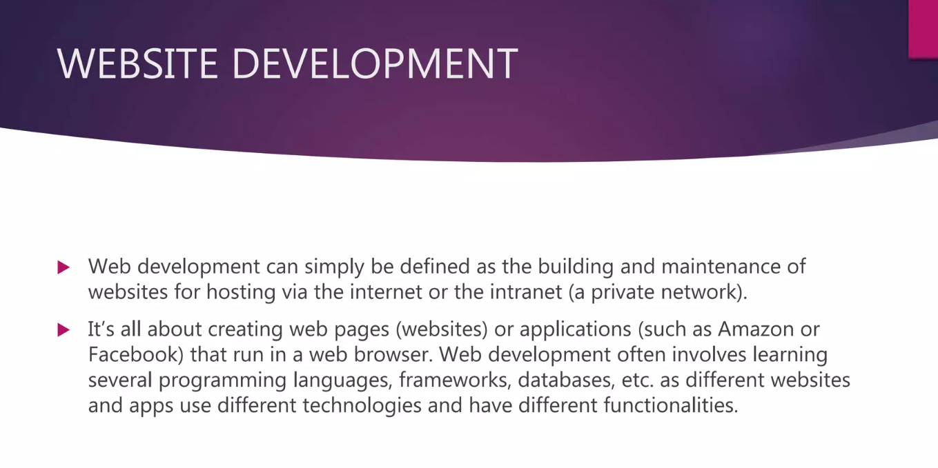

Slide 5


Slide 6
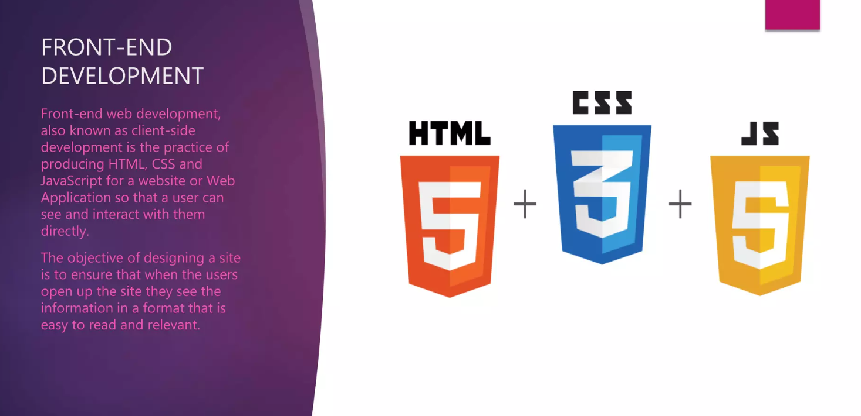

Slide 7
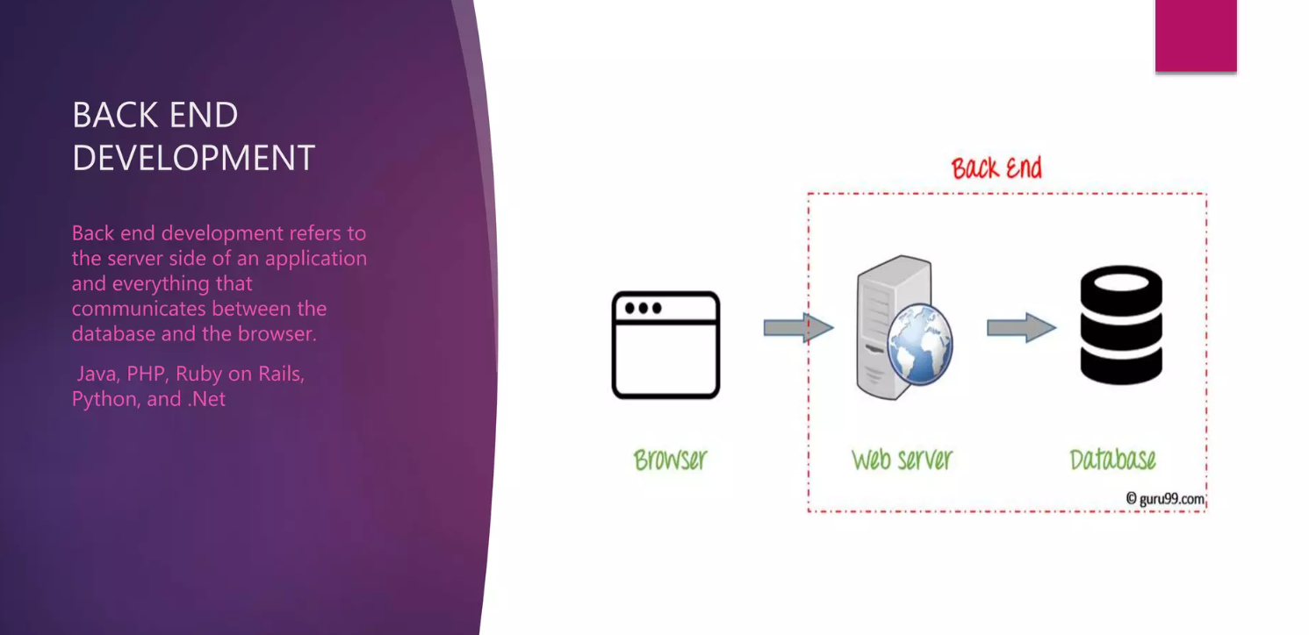

Slide 8
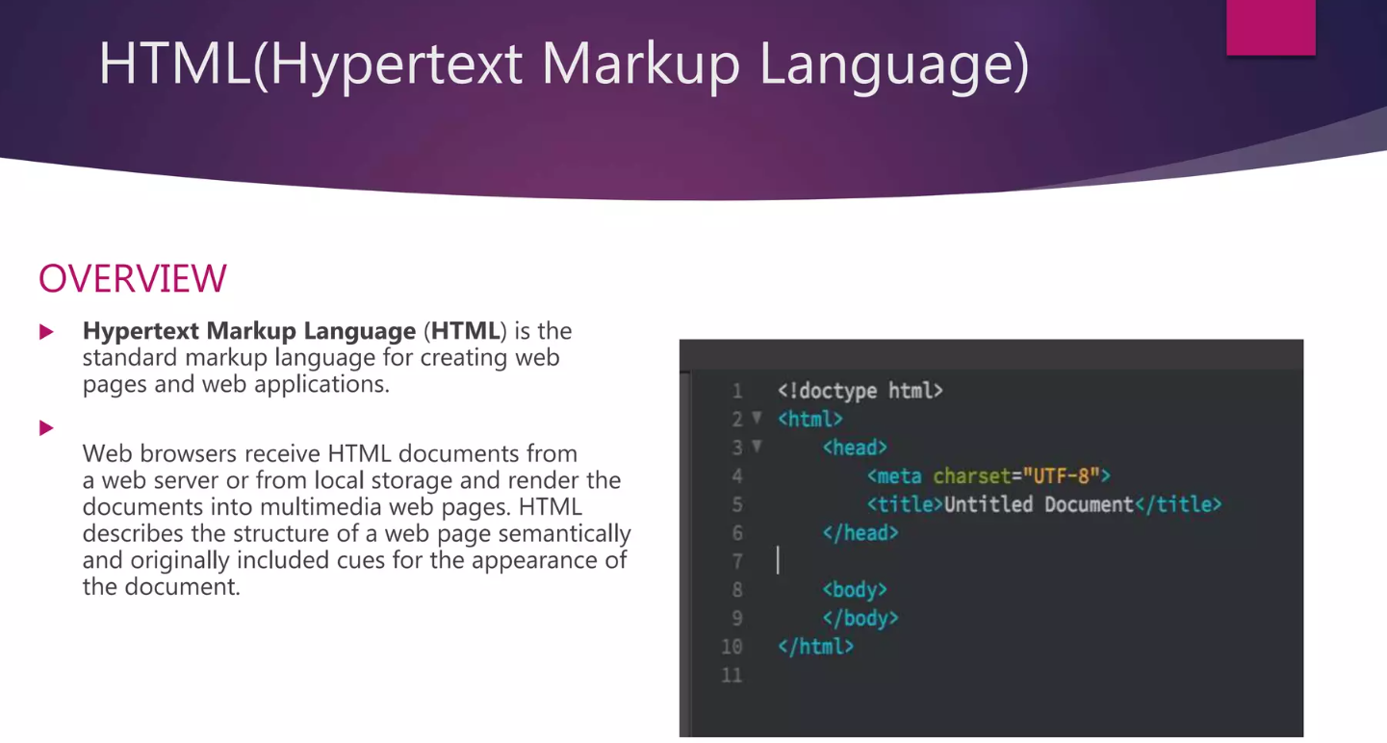

Slide 9
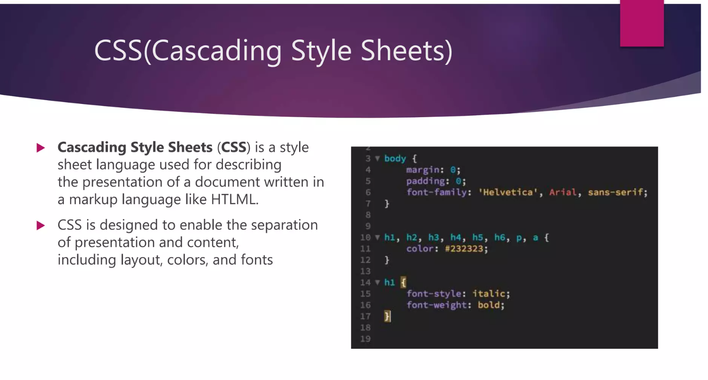

Slide 10
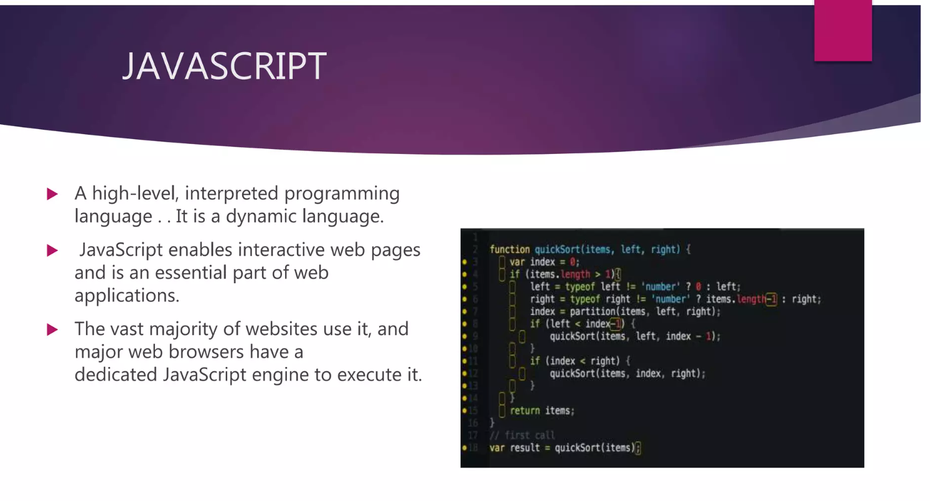

Slide 11
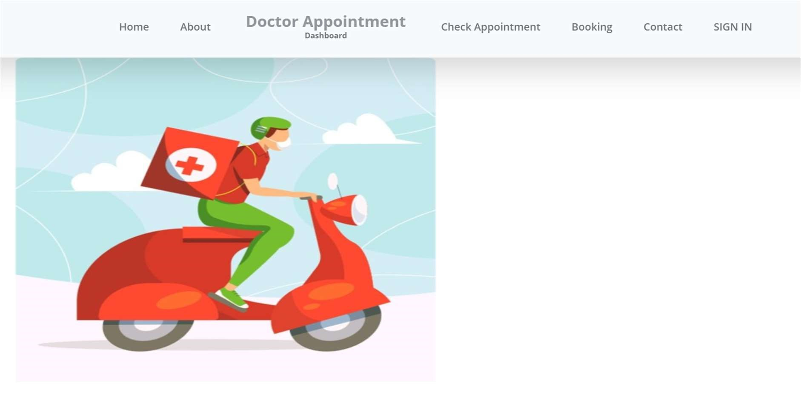

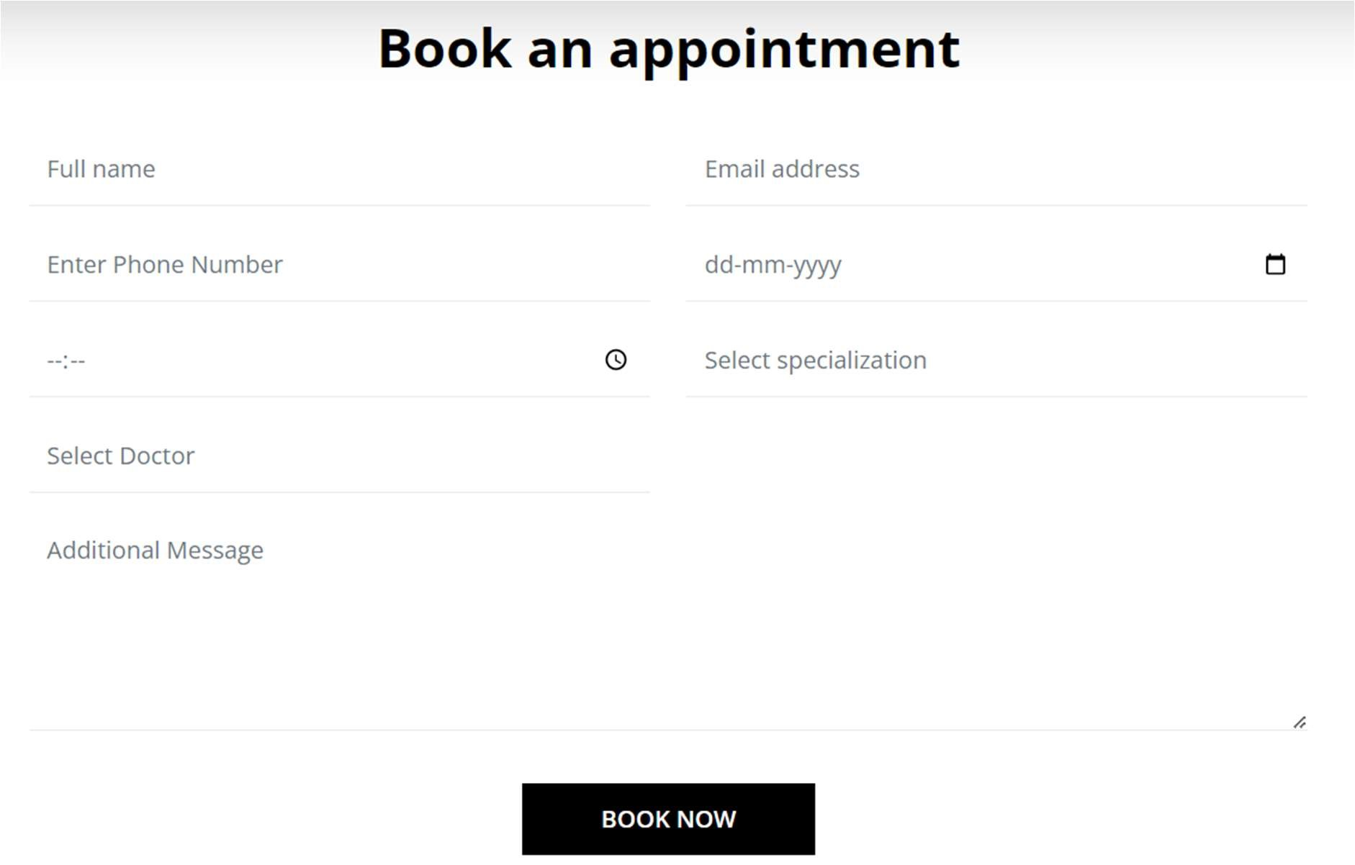

Slide 12
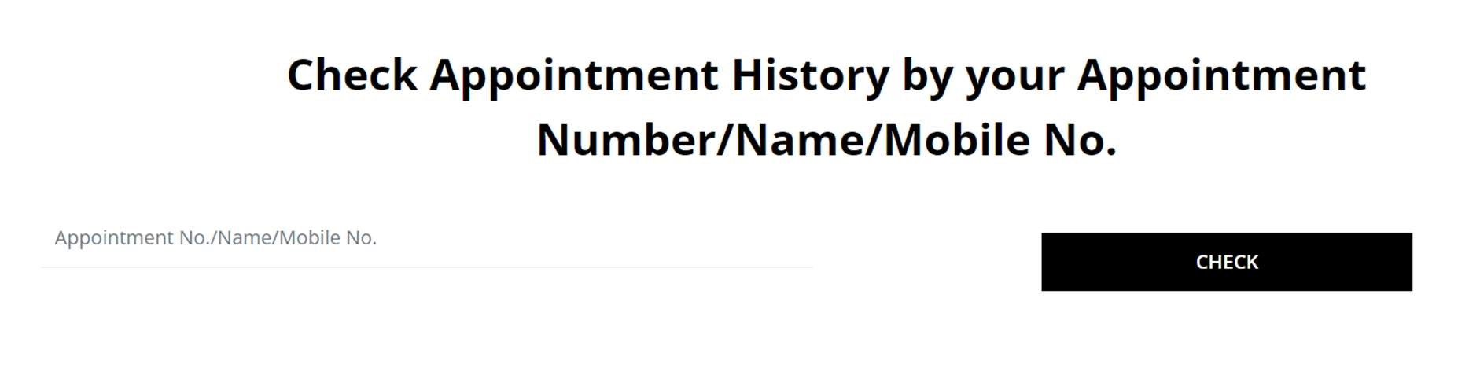
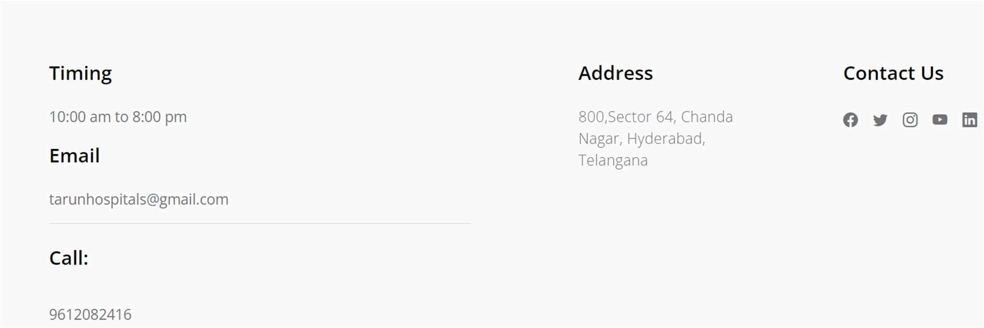
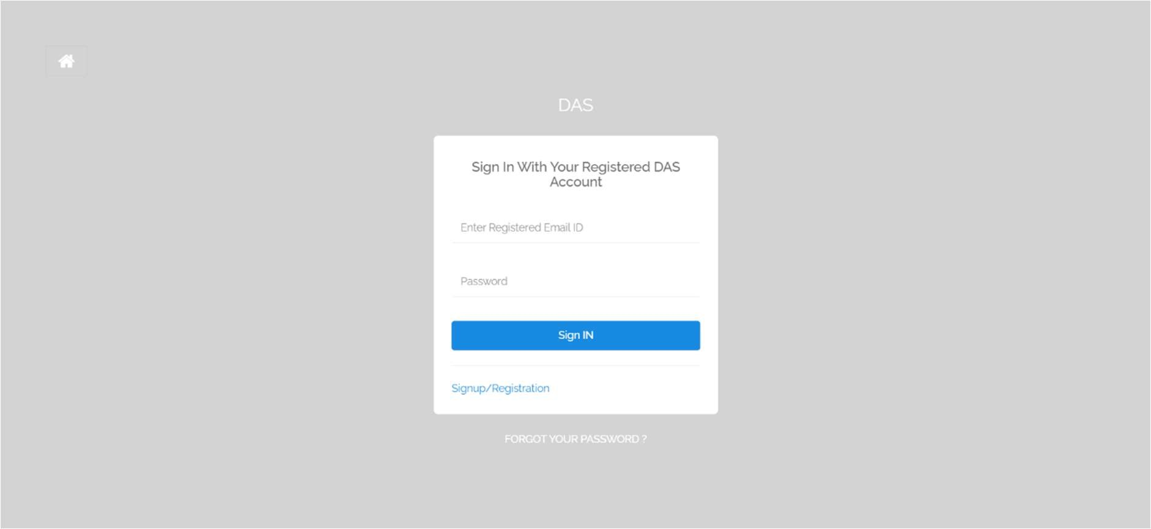

Slide 13
Conclusion:
The Doctor Appointment Dashboard System offers a comprehensive solution to optimize and streamline the appointment scheduling process in healthcare facilities. By automating the process, the system improves efficiency, reduces waiting time, and enhances patient satisfaction. The implementation of this system provides doctors and administrators with real- me visibility into appointments, enabling be er resource utilization and minimizing scheduling conflicts. Additionally, the system promotes effective communication between doctors, patients, and staff members, leading to a more patient-centric approach to healthcare. Overall, the Doctor Appointment Dashboard System significantly enhances the appointment scheduling experience and contributes to improving the overall efficiency of healthcare facilities

Slide 14
Thankyou

